Slide 1

Invitation to Bid
Major Fall River Development Opportunity
Property Along the Rt. 79 Davol Street Corridor
Virtual Informational Meeting
August 5, 2026
MassDOT #17580 · ITB #30076920.4 · Sale of ±20 Acres
This document is for informational purposes only; bidders should rely only on the ITB as the controlling procurement document.

Slide 2

The Opportunity
Transaction Terms
Procurement & Flexibility
Timeline
Key Dates & How to Bid
Table of
Contents
This document is for informational purposes only; bidders should rely only on the ITB as the controlling procurement document.

Slide 3
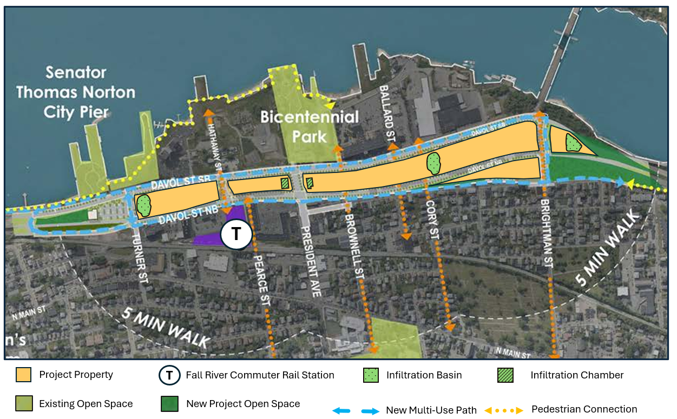
The Opportunity
A rare, large-scale transit-oriented development site.
3
Rt. 79 Fall River · Invitation to Bid
±20
1,400+
By-Right
ACRES
UNITS
WTOD ZONING
Newly created, vacant
Master Plan estimate
Adopted 2024
Transit-ready. Directly across from the new MBTA Fall River Depot commuter rail station; the entire site sits within a ¾-mile walk. SRTA bus service runs along Davol Street.
By-right zoning. The Waterfront & Transit-Oriented Development (WTOD) District (2024) permits multifamily and mixed-use as-of-right, with reduced parking ratios.
Shovel-ready ground. Water, sewer, gas, and electric stubbed to the parcels. A decade of planning, environmental review, and public infrastructure investment is complete.
Highway-connected. Frontage on Davol Street with immediate access to Route 24, Route 79, and the Braga Bridge (Interstate 195) quick reach to Providence, Boston, and the South Coast.
This document is for informational purposes only; bidders should rely only on the ITB as the controlling procurement document.

Slide 4
Transaction Terms
7
Market responsive deal structure under the ITB
Structure
Basis of award
Deposits and Option Fee
Single agreement for the sale of the entire ±20-acre Property to one Designated Developer, sold and built out in phases under an approved Phasing Plan.
Qualifications judged pass/fail.
The qualified bidder offering the highest Minimum Guaranteed Price (MGP) is designated.
$25,000 bid deposit, $500,000 P&S deposit, payable $250,000 at P+S signing and $250,000 on the fifth anniversary; all credited to the purchase price at the final closing.
$25,000 annual option payment, credited at the next closing.
Due Diligence
Phased closings
“As-is” sale
9-month due diligence period.
Three additional months to agree on a Phasing Plan.
Initial Closing on the first phase effectively 2 years from P+S execution; Later Closings at least every 3 years; final payment no later than 10 years after Initial Closing.
Property sold as-is, where-is; the developer permits each phase. MassDOT maintains the land until each parcel is acquired.
This document is for informational purposes only; bidders should rely only on the ITB as the controlling procurement document.

Slide 5
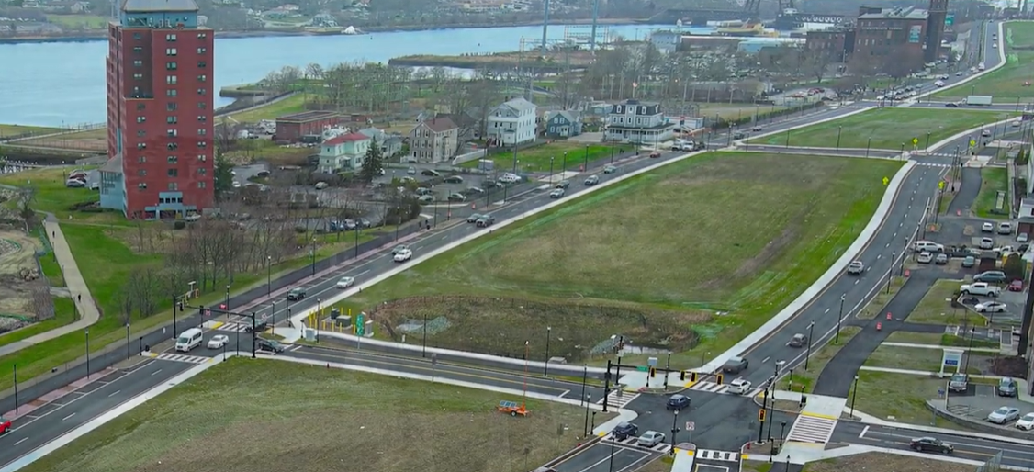
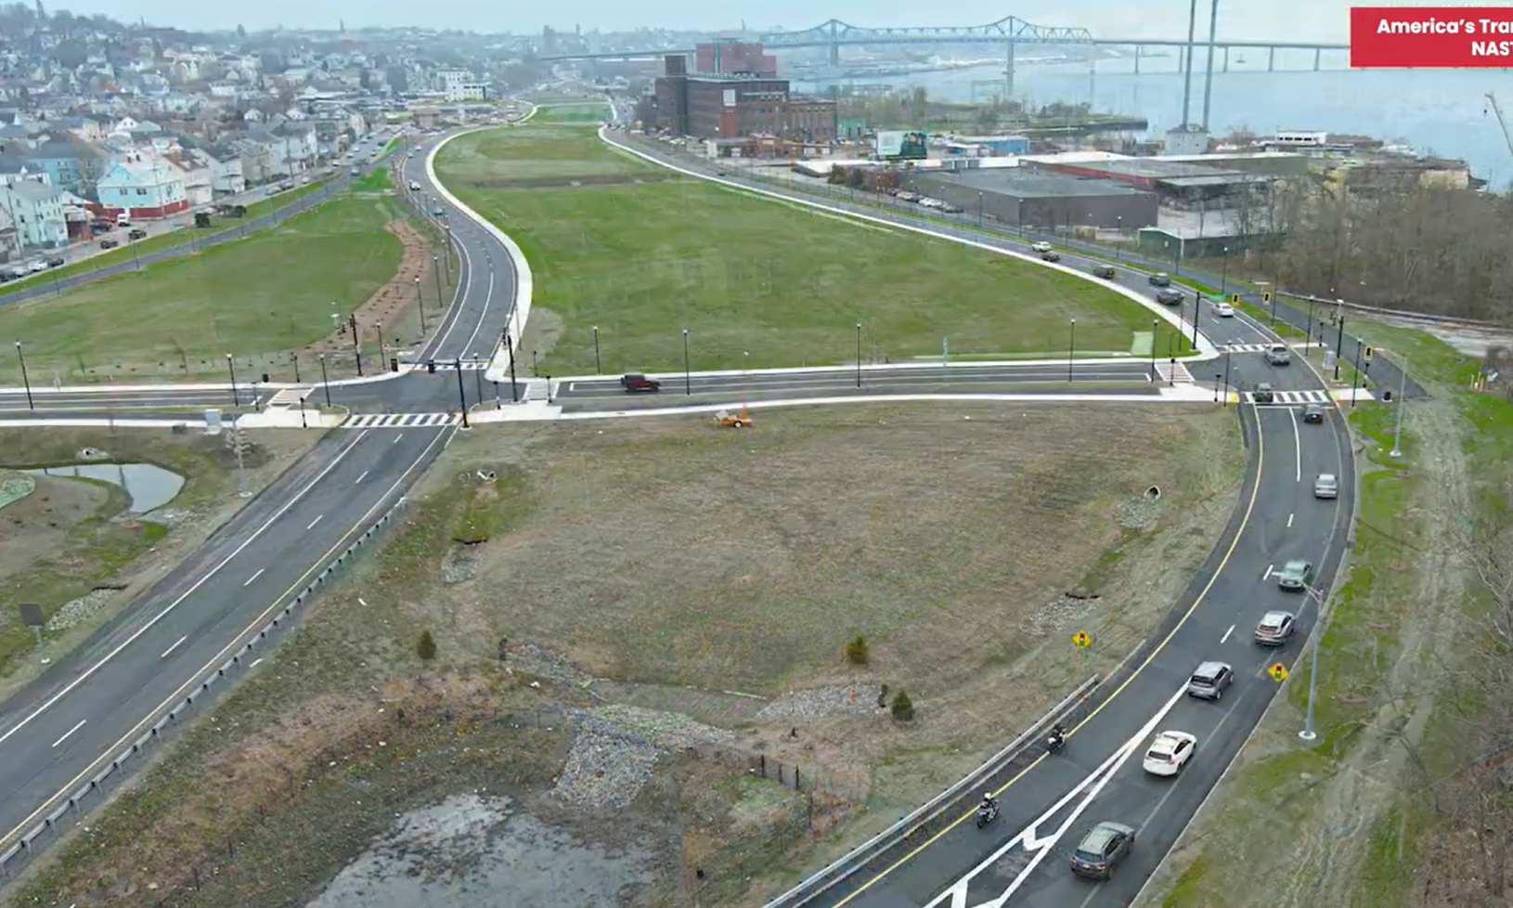
Procurement — Built for Flexibility
8
Terms designed to reduce friction and speed development
Flexible timing, configuration & sequencing. The developer sets parcel boundaries and phase order through the Phasing Plan — a potential horizon of 12 years.
Incentives available to bidders
Closing after entitlements. Generous closing terms (9-months of due diligence; 3-month period beyond the Due Diligence Period to agree to a Phasing Plan; then 12 months to Initial Closing).
Assign or partner on future phases. MassDOT allows assignment or partnering for later phases, consistent with the approved plan and price allocations.
Pricing absorbs change. Pre-agreed Use Prices set the method for changes in unit count or commercial space, so scope can grow predictably.
This document is for informational purposes only; bidders should rely only on the ITB as the controlling procurement document.

Slide 6
Timeline
9
From bid to phased buildout — key milestones & payments
Bid Due
P&S Execution
Due Diligence &
Phasing Plan
Initial Closing
Phased Buildout
Oct 21, 2026
≤ 60 days after selection
≤ 1 yr from Agreement
≤ 1 yr after plan
Later closings ≥ every 3 yrs
1
2
3
4
5
Bid deposit
$25,000
P&S deposit
$250,000
Elect to proceed →
deposits earned
Initial payment
(portion of MGP)
Final payment
≤ 10 yrs after initial closing
Recurring: Option fee $25,000/yr to hold future phases · second $250,000 P&S deposit at the 5th anniversary of the P&S execution date.
Potential Horizon: ~12 years total. MGP = Minimum Guaranteed Price; most deadlines are stated as “no later than.”
This document is for informational purposes only; bidders should rely only on the ITB as the controlling procurement document.

Slide 7
Key Dates & How to Bid
10
Procurement schedule and where to get the documents
Procurement schedule
ITB Released | Jul 23, 2026
Virtual Informational Meeting | Aug 5, 2026 · 2:00 pm
Pre-Submission Meeting + Site Visit | Aug 12, 2026 · 10:00 am
1st Written Questions Due | Aug 26 (responses Sep 9)
2nd Written Questions Due | Sep 23 (responses Oct 7)
Bids Due | Oct 21, 2026 · 12:00 pm
Designation of Developer | Estimated October 2026
How to participate
Register at route79davolstdevelopment.com to receive announcements, addenda, and procurement updates.
ITB, site map & data room:
route79davolstdevelopment.com
Meet with the City:
As part of its evaluation of this opportunity, Bidders are encouraged to meet with the City of Fall River before submitting a bid.
Bid deposit: $25,000 certified check payable to “Massachusetts Department of Transportation,” due with the bid.
Contact — Greystone Real Estate Advisory Group
Procurement@MassDOTrealty.com
This document is for informational purposes only; bidders should rely only on the ITB as the controlling procurement document.

Slide 8
Questions & Comments
Responses provided today are for informational purposes only;
formal questions should be submitted to procurement@massDOTrealty.com.

